Slide 1

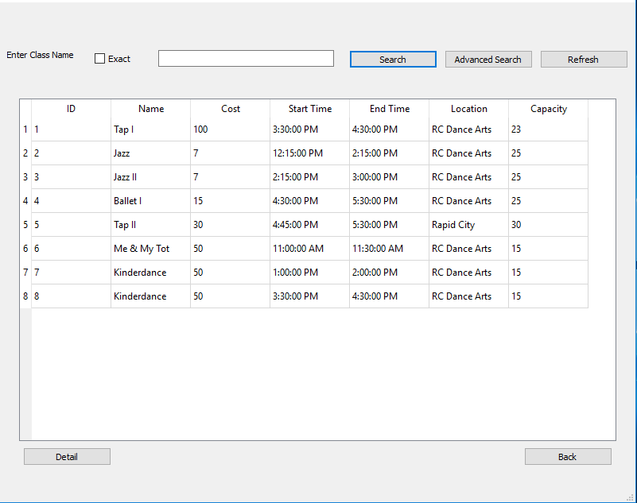
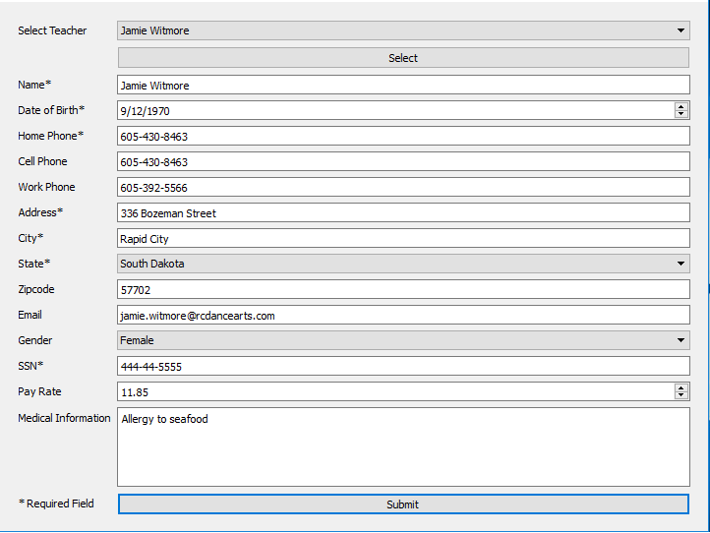
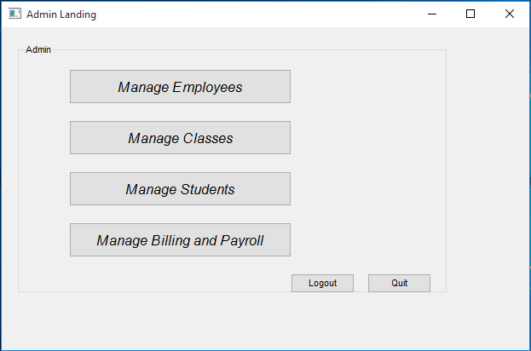
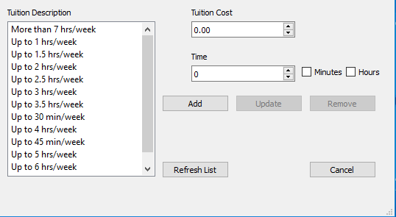
DanceSoft
Special Thanks
Brian Butterfield
Dr. Mengyu Qiao
Roger Schrader
Team Members: Marcus Berger and Dicheng Wu
Project Sponsor: Dr. Jeff McGough
User Interface
Academy of Dance Arts
Architecture and Database
The Academy of Dance Arts is a dance school in Rapid City, and Sturgis, South Dakota. The academy provides dance classes in a variety of disciplines to students of all ages. These classes range from Kinderdance, Ballet and Tap to Hip-Hop and Jazz.
General Description
Improve the client description
General Simple Data Description
Need GUI ARCH.
Project Overview
Need Database Diagram
The DanceSoft project is a data management software for the Academy of Dance Arts in Rapid City. The project aims to produce a simple and more effective tool then what is currently in use at the academy. This will be accomplished through the use of a database and a simple user friendly interface, which will allow faculty and students to easily accomplish their needs, whether that's registering for a class, getting a class role sheet or just general employee management. DanceSoft aims to provide effective management tools so the academy spends less time at their computers, and more time teaching students the wonders of dance.
List Highlights
Search Pages
Forms Pages
Landing Pages

